Slide 1
Human Face recognition Attendance system Group member: 1. Farhat Tasnim - 1410482042 2. K.M.H.Mubin – 1621802042
.

Slide 2
Abstract
Authentication is one of the significant issues in the era of information system. Among other things, human face recognition (HFR) is one of known techniques which can be used for user authentication. However, it is difficult to estimate the attendance precisely using each result of face recognition independently because the face detection rate is not sufficiently high.
Continuous observation improves the performance for the estimation of the attendance we constructed the lecture attendance system based on face recognition, and applied the system to classroom. This paper first review the related works in the field of attendance management and face recognition. Then, it introduces our system structure and plan.
Finally, experiments are implemented to provide as evidence to support our plan. The result shows that continuous observation improved the performance for the estimation of the attendance.

Slide 3
Aim and objective
Our aim is to build up a face recognition system where a human will stand in front of the system and a camera will match the face along with its database.
There will no extra RFID card people need to carry any more and this system will be the most authentic system of taking attendance. We will try to build this system as efficient as possible.

Slide 4
Motivation
As we are making a system which can recognize face and match with its own database. It will make the attendance system more authentic. Our primary goal is to help the lecturers, improve and organize the process of track and manage student attendance and absenteeism.
Additionally, we seek to provide a valuable attendance service for both teachers and students. Reduce manual process errors by provide automated and a reliable attendance system uses face recognition technology.
Increase privacy and security which student cannot presenting himself or his friend while they are not. Flexibility, Lectures capability of editing attendance records.

Slide 5
Advantages
The system stores the faces that are detected and automatically marks attendance.
Ease of use is manipulate and recognize the faces in real time using. Multiple face detection. Multipurpose software Can be used in different places.

Slide 6
Disadvantages
The accuracy of the system is not 100%. It can only detect face from a limited distance.

Slide 7
Current Status
There are lots of mature works involving face recognition attendance system. Some people worked on Discrete Wavelet Transforms (DWT), some worked on image processing, some worked on ultrasonic sensor, and some worked on Discrete Cosine Transform (DCT) etc.
Till now the best work is “AUTOMATED ATTENDANCE MACHINE USING FACE DETECTION AND RECOGNITION.” Of UNIVERSITY OF NAIROBI. Another work is “Automatic Attendance System Using Face Recognition.” Of IJMTER University.

Slide 8
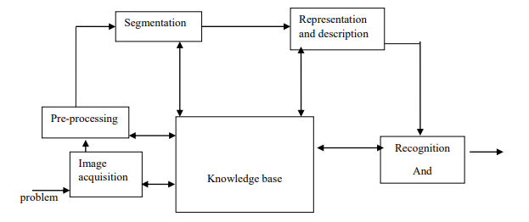
Plan of work

Slide 9
Plan of work
We have divided our work into two parts.
1. Sensing Face and capture.
2. Match with data base.

Slide 10
Sensing Face and capture
Face detection involves separating image windows into two classes; one containing faces (turning the background (clutter).
It is difficult because although commonalities exist between faces, they can vary considerably in terms of age, skin color and facial expression. The problem is further complicated by differing lighting conditions, image qualities and geometries, as well as the possibility of partial occlusion and disguise. An ideal face detector would therefore be able to detect the presence of any face under any set of lighting conditions, upon any background. The face detection task can be broken down into two steps.
The first step is a classification task that takes some arbitrary image as input and outputs a binary value of yes or no, indicating whether there are any faces present in the image. The second step is the face localization task that aims to take an image as input and output the location of any face or faces within that image as some bounding box with (x, y, width, height).

Slide 11
Match with database
After taking the picture the system will compare the equality of the pictures in its database and give the most related result.
We will use raspbian operating system, open CV platform and will do the coding in python language.

Slide 12
Justification and novelty
There is still no work combining image processing by raspbian operating system with open CV platform. So, we want to introduce this model.

Slide 13
Milestones and time frame
Work | Time
Buying products | 1 week
Learning image processing and applying it | 3 weeks
Write the system code | 2 weeks
Using camera for image processing | 2 weeks
Assembling everything | 3 weeks

Slide 14
Specifications of the product
HD Webcam (Camera Module).
Raspberry pie.
Battery for energy source.
SD card.
Laptop

Slide 15
Tentative budget with item wise breakup
Item | Taka
HD Webcam (Camera Module) | 3000
Raspberry pie | 4500
Battery | 1000
SD card | 500
Glue | 100
Wires and others | 1000

Slide 16
Thank You
.

